Slide 1



Cascade funding
Yaneiza Méndez
This project has received funding from the European Union's Horizon 2020 INNOSUP Programme from the Grant Agreement No 101005711

Slide 2

Consortium

Slide 3
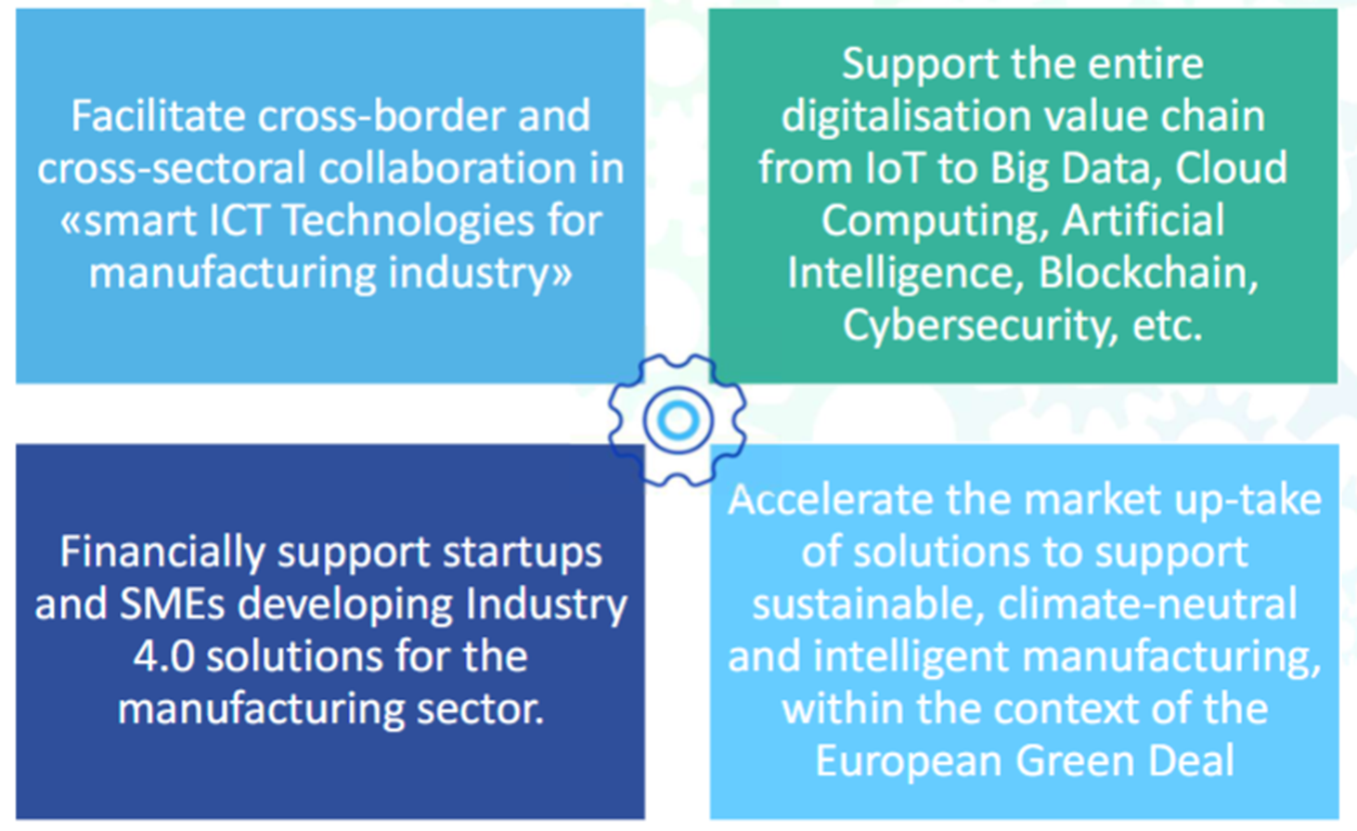
Objectives

Slide 4
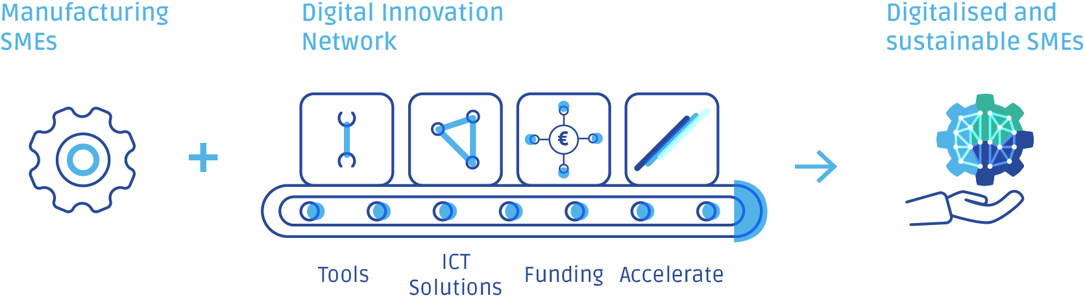
Approach
M4M Support
Investment Readiness Level (IRL) Self-Assessment
Open Innovation Platform
Open Calls
Acceleration Programs

Slide 5
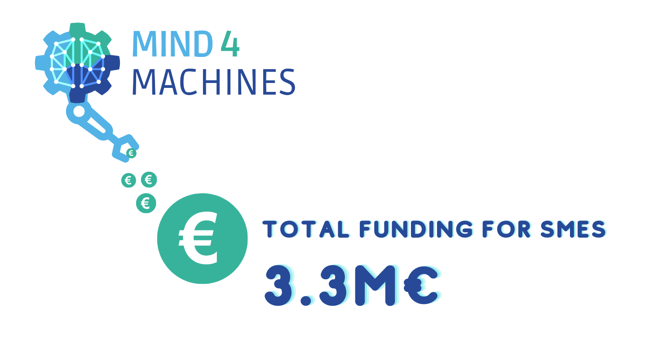
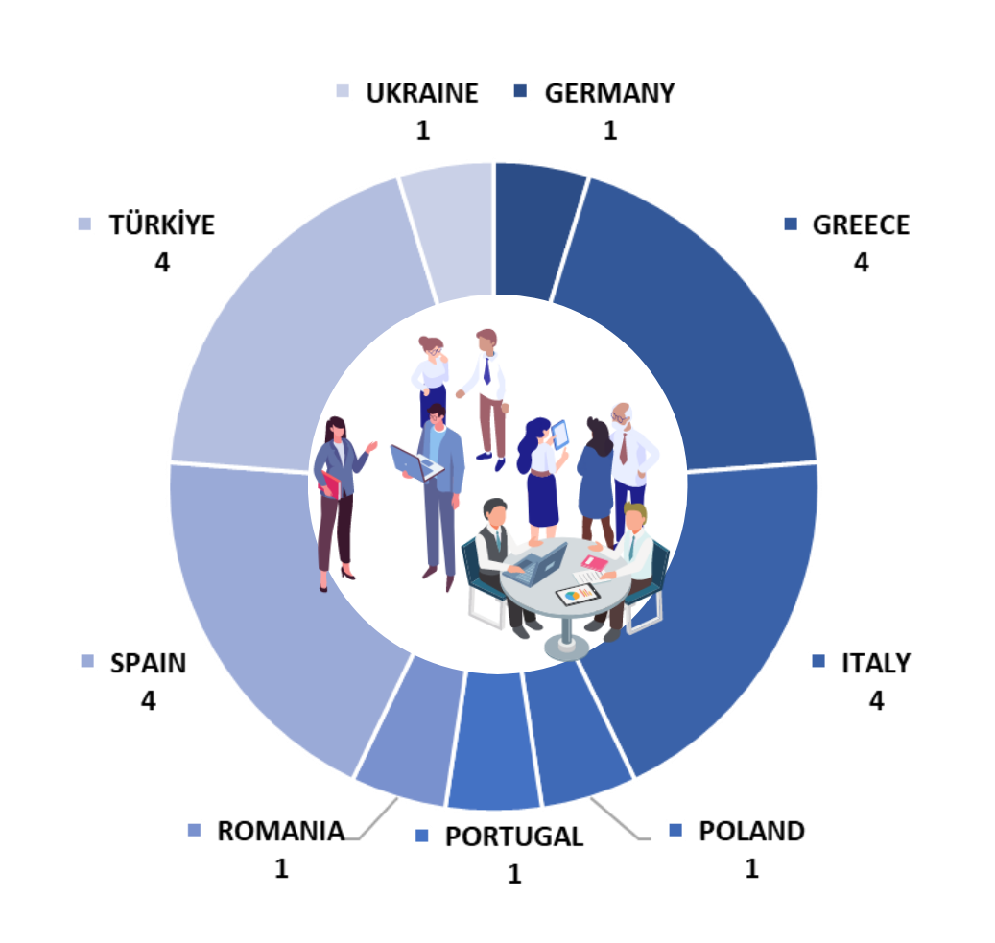
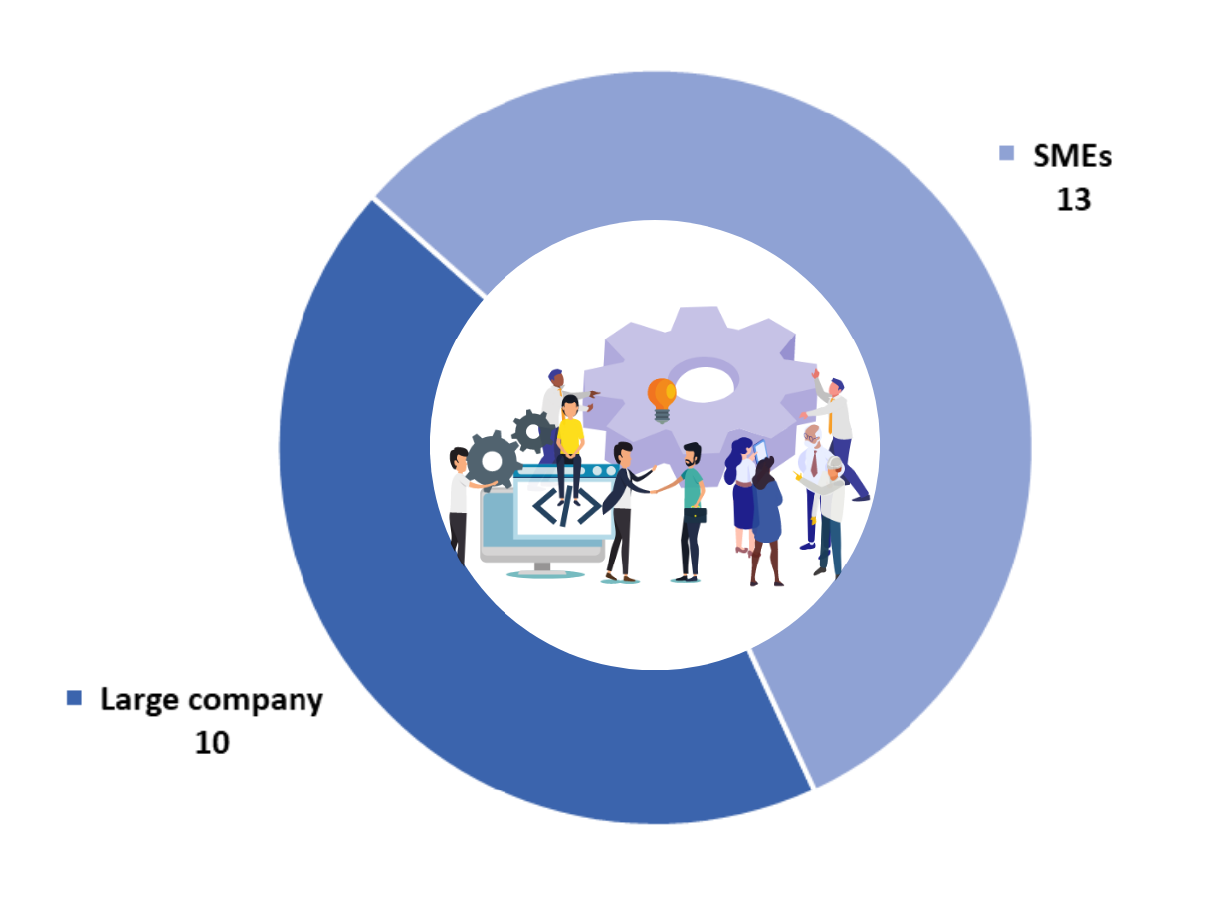

M4M numbers
Main Applicants of the 21 selected projects come from
Industrial
partners

Slide 6

Benefits for SMEs
Access to additional funding.
Expansion of collaboration networks.
Support for innovation and technological development.
Internationalization and access to new markets.
Risk reduction in investment.
Increased visibility and reputation at the European level

Slide 7

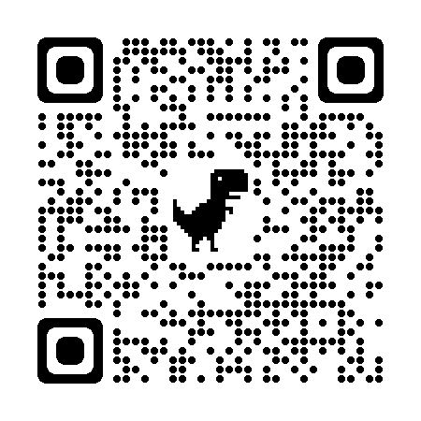
¡ Muchas gracias !
Project Manager
AECIM
https://www.linkedin.com/in/yaneiza-mendez/

